Slide 1
Our first year with Globe
United School of St. Francis of Assisi
Karloveská 32, Bratislava

Slide 2
Which classes have been involved ?
Most pupils from 5th and 6th grade of primary school have taken part in the project, which has involved approximately 250 pupils.
The activities themselves were assigned online as homework by our teachers Oľga Straková and Martina Klieštiková.
This years project has been focused on Meteorology and Phenology.

Slide 3
Meteorology
The first task consisted of observing the sky and was done by 5-graders during the Geography lessons.
Observation of the sky took place in February and March on two lessons.
The pupils received an observation homework after the lessons. The focus of this homework was to observe the sky at the same time every day for a week. The results were then put into a table.

Slide 4
Showcase of observation results and photographs

Slide 9
Phenology
The second task of the project involved observing different stages of the leaf buds growth.
The teachers have helped us observing the growth of leaf buds then she entered her records into the Globe database.

Slide 10
Showcase of observation results and photographs

Slide 11
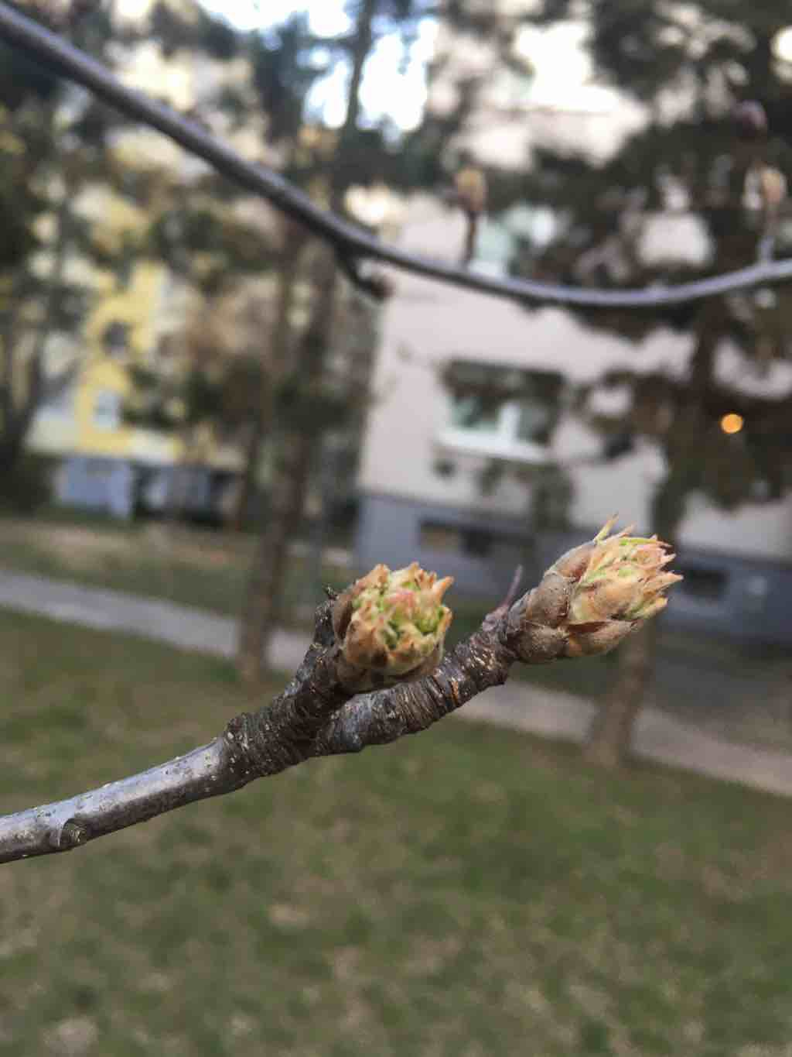

Slide 12
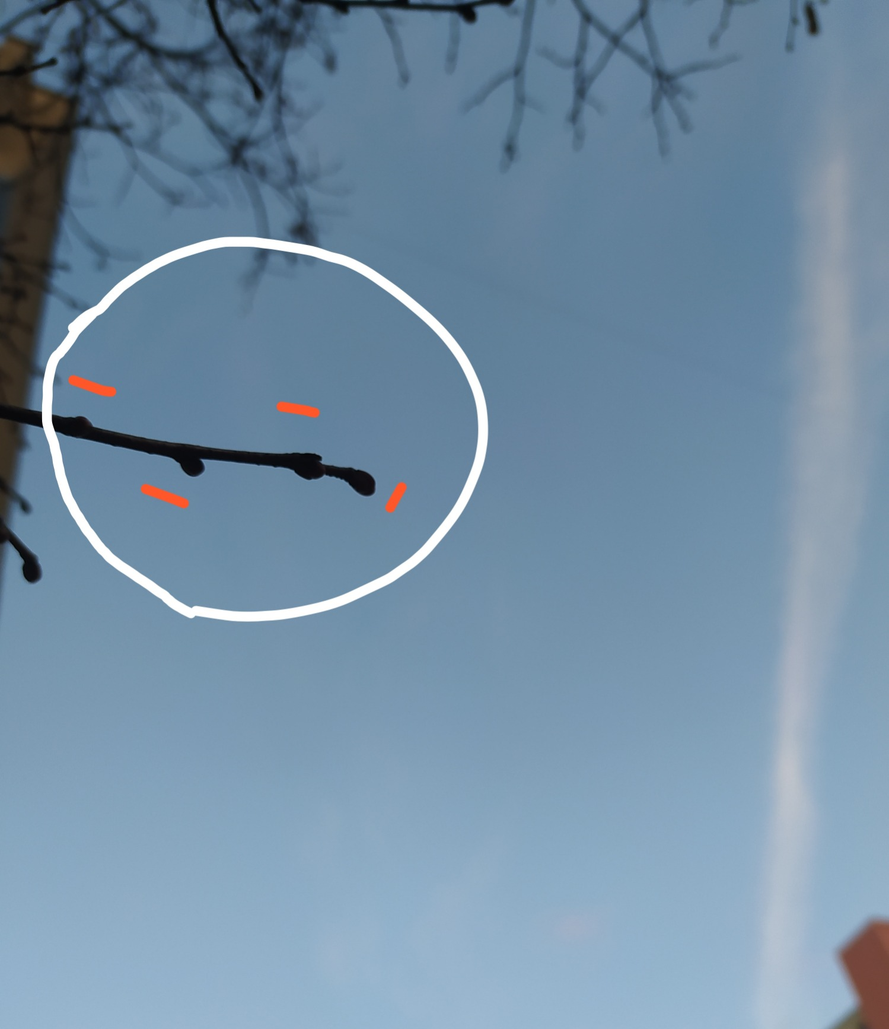

Slide 13
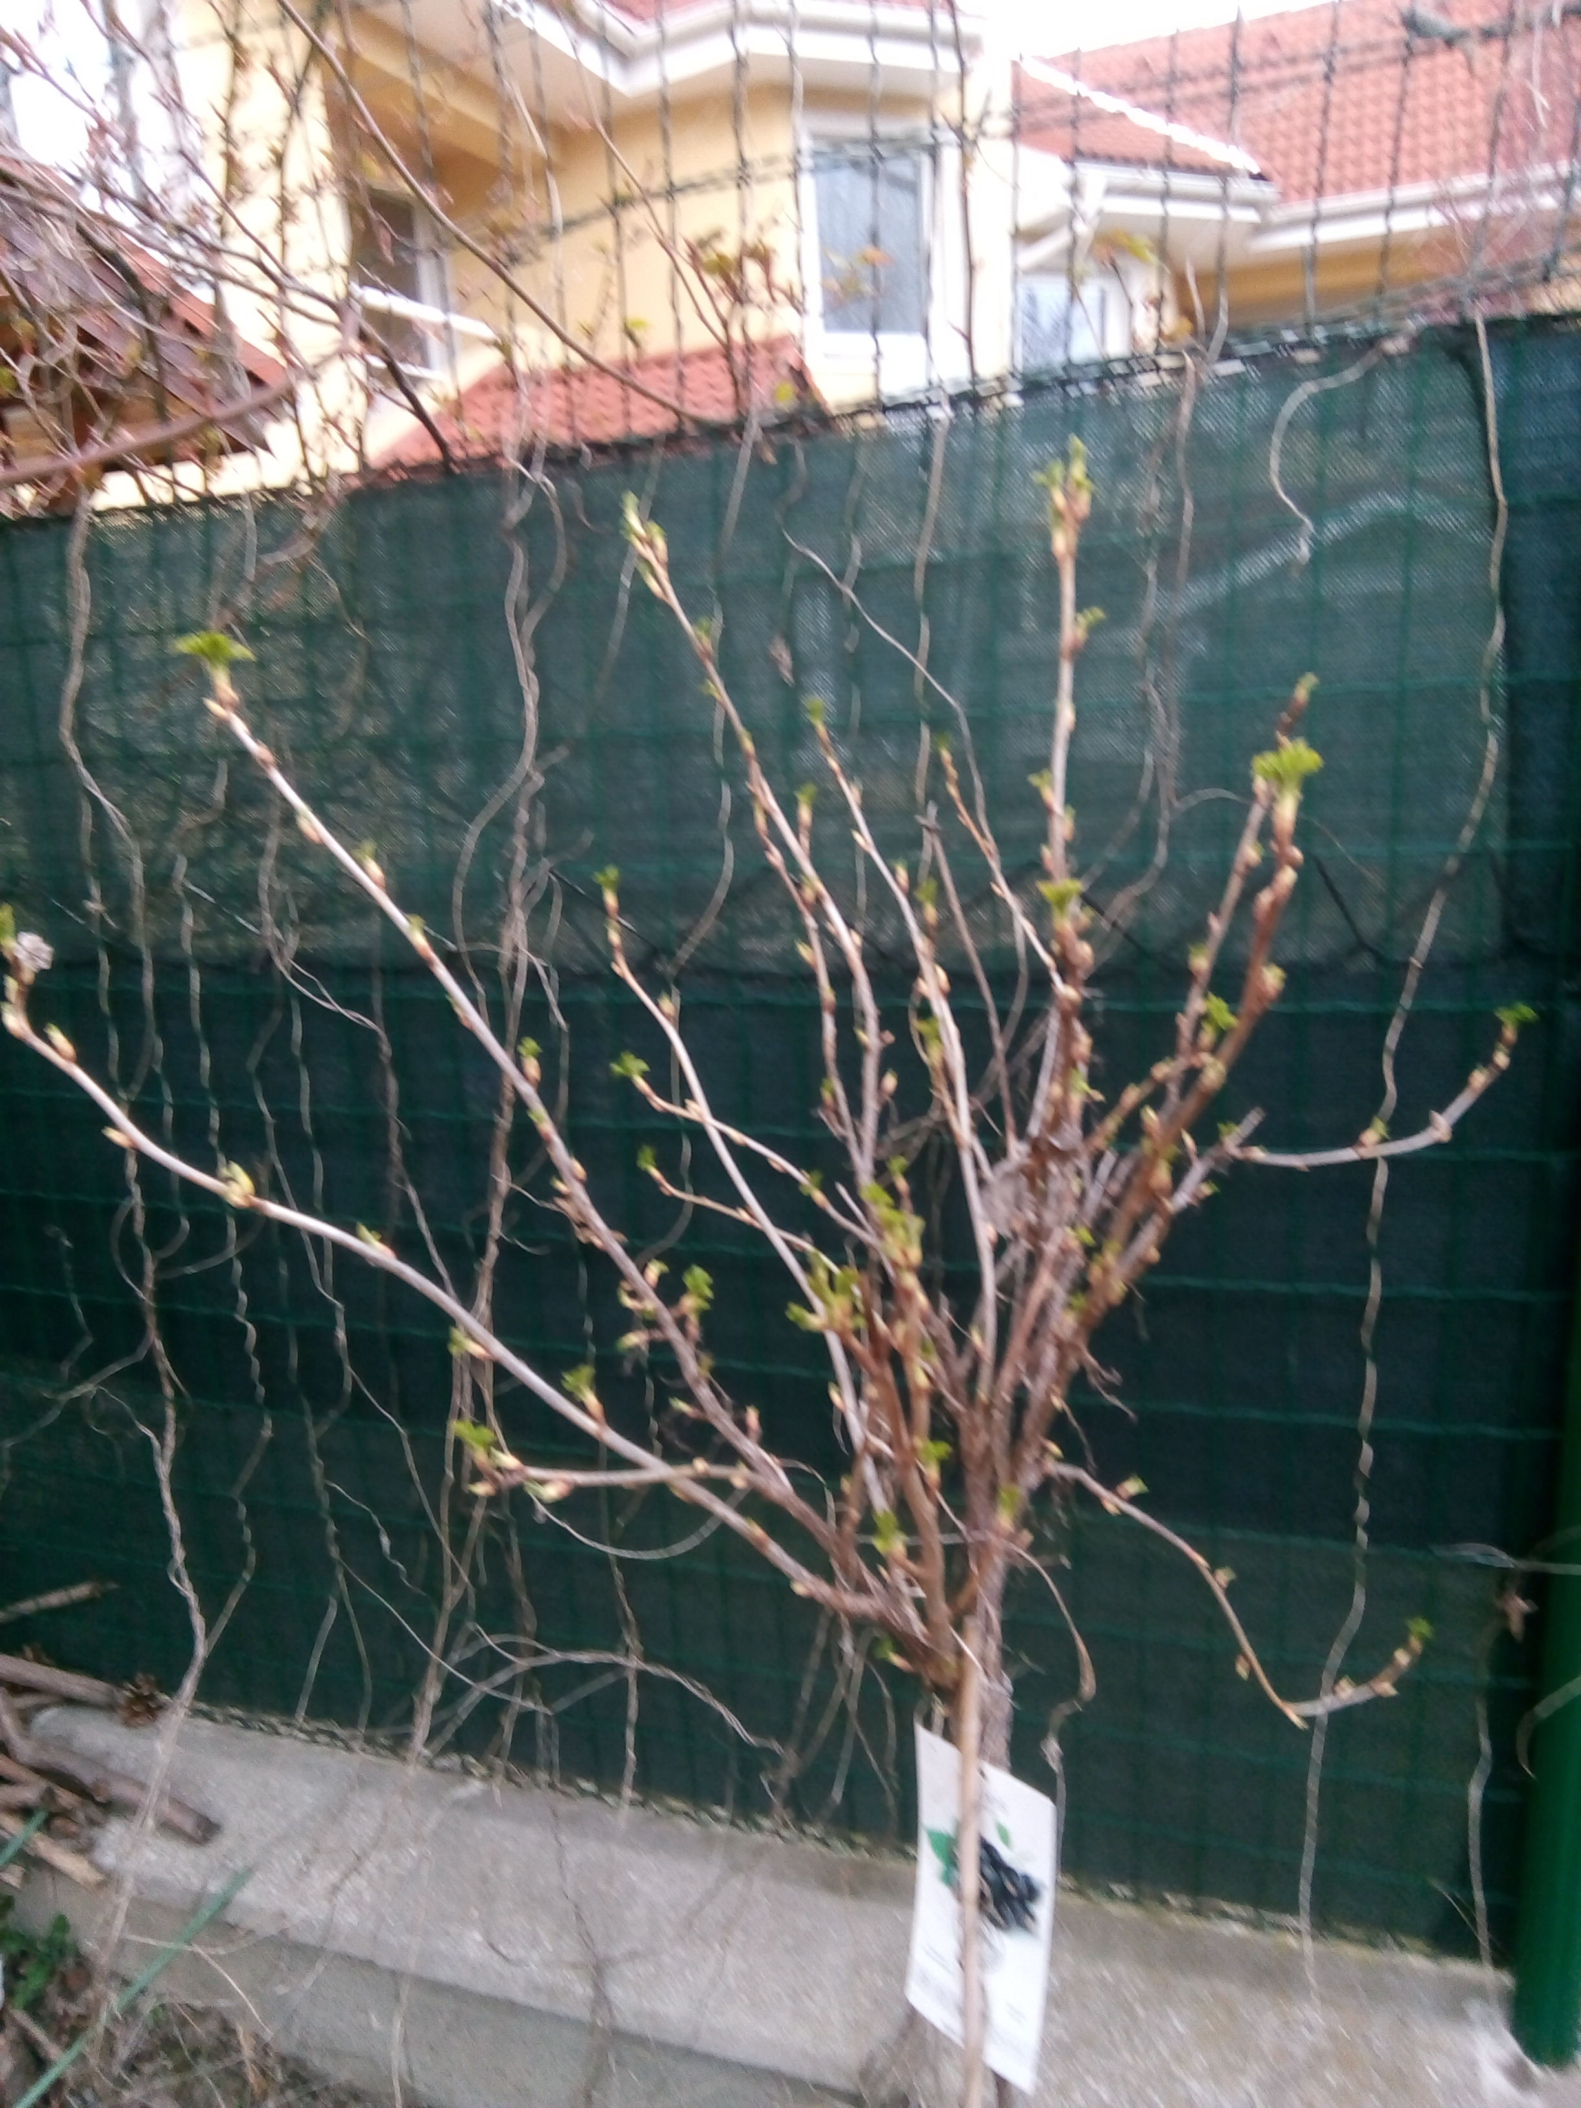
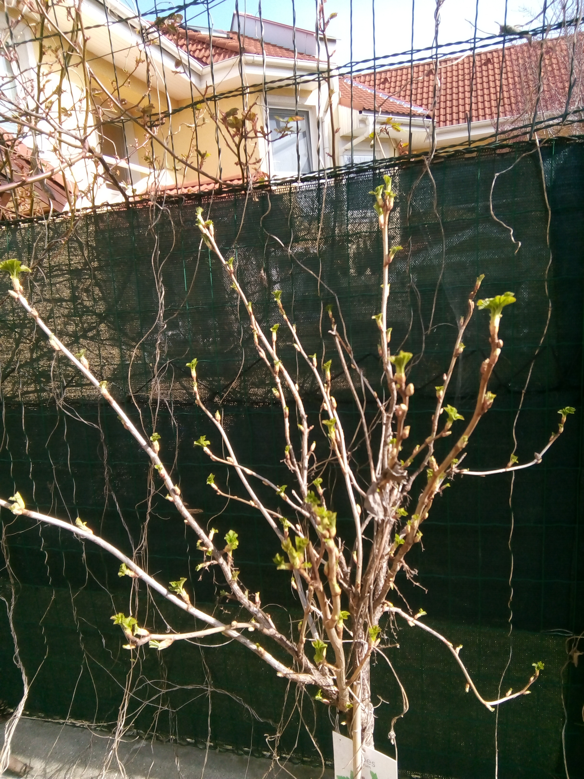
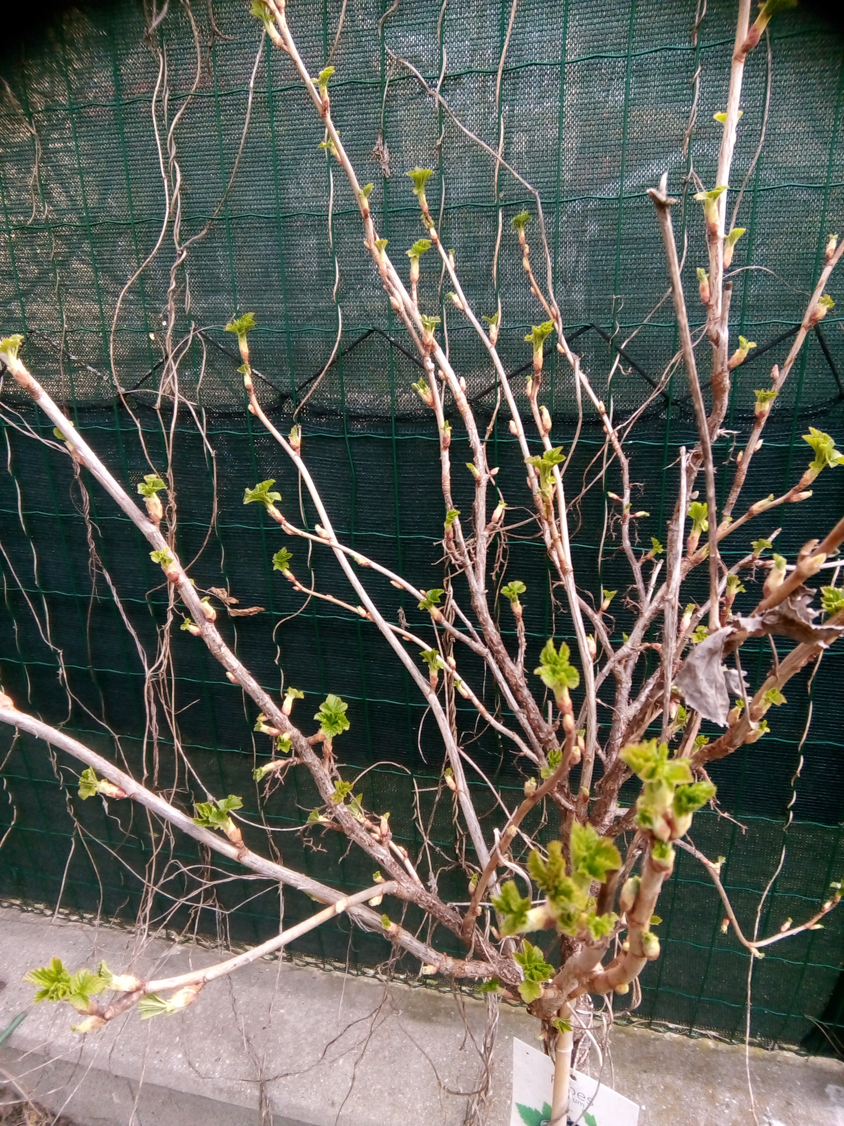
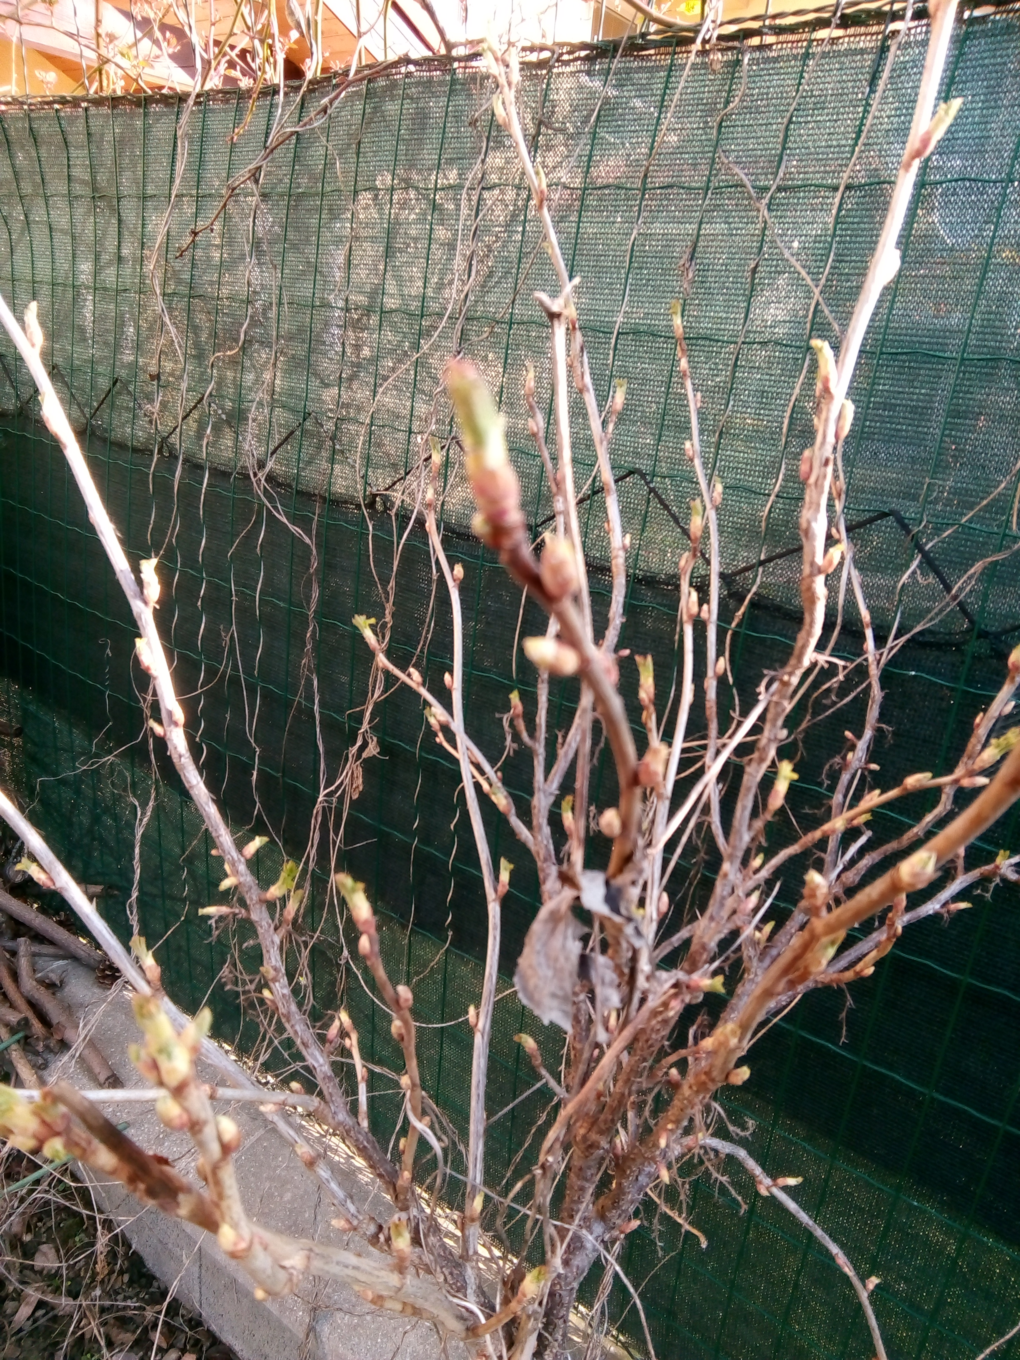
Biology project Observing buds
I watched the blackcurrant fruit bush.
Location: Bratislava on Mečíkova street.
C:\Users\Ondrej\Desktop\IMG_20210328_105916.jpg
Sunday 29.3.

Slide 14
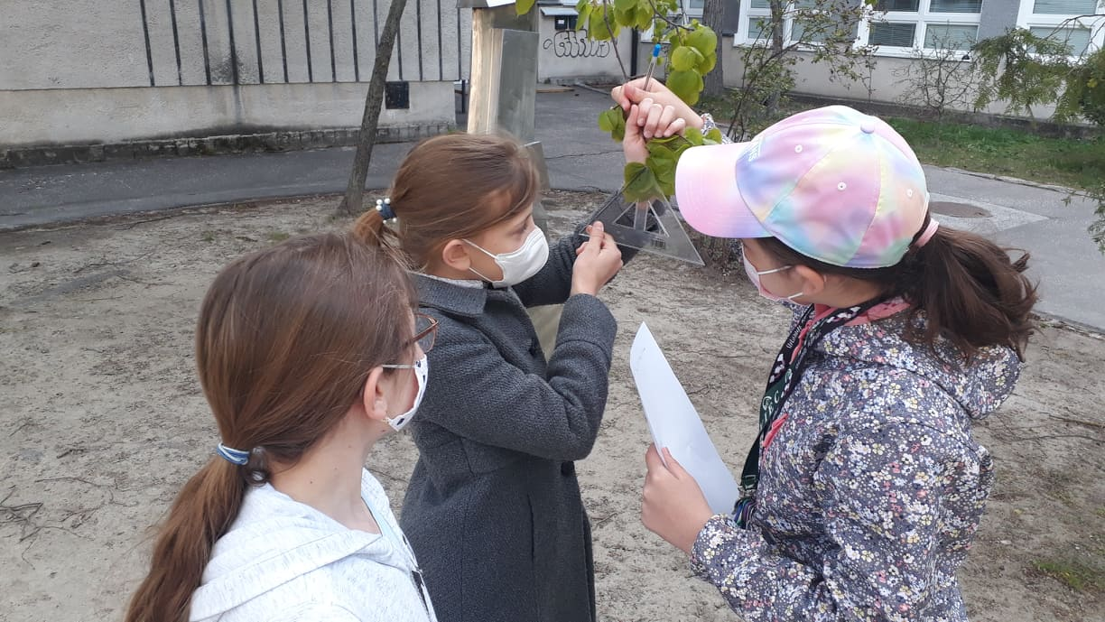
Observing the leaf growth after returning to the school

Slide 15
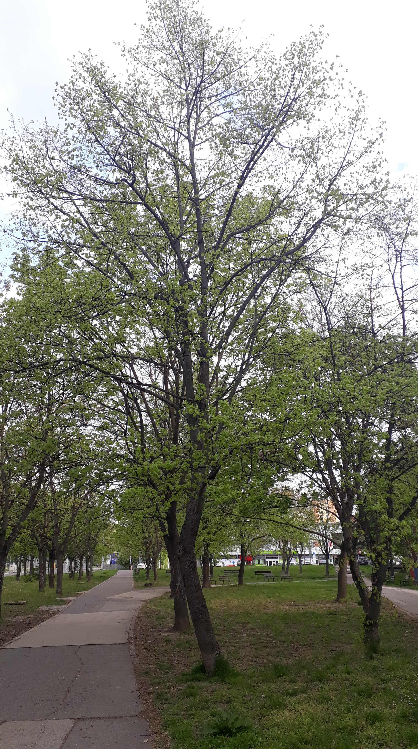
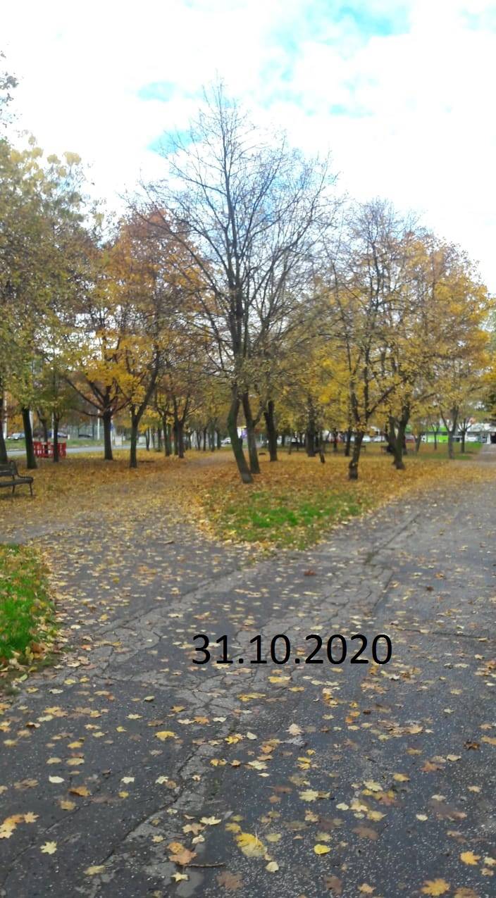
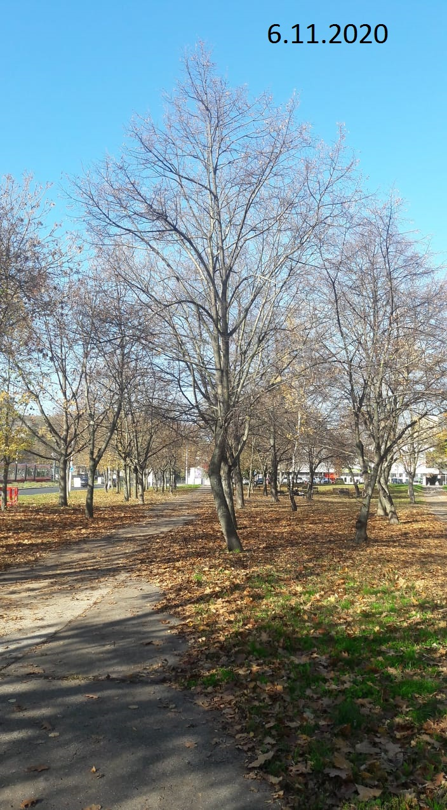
Our school tree

Slide 16
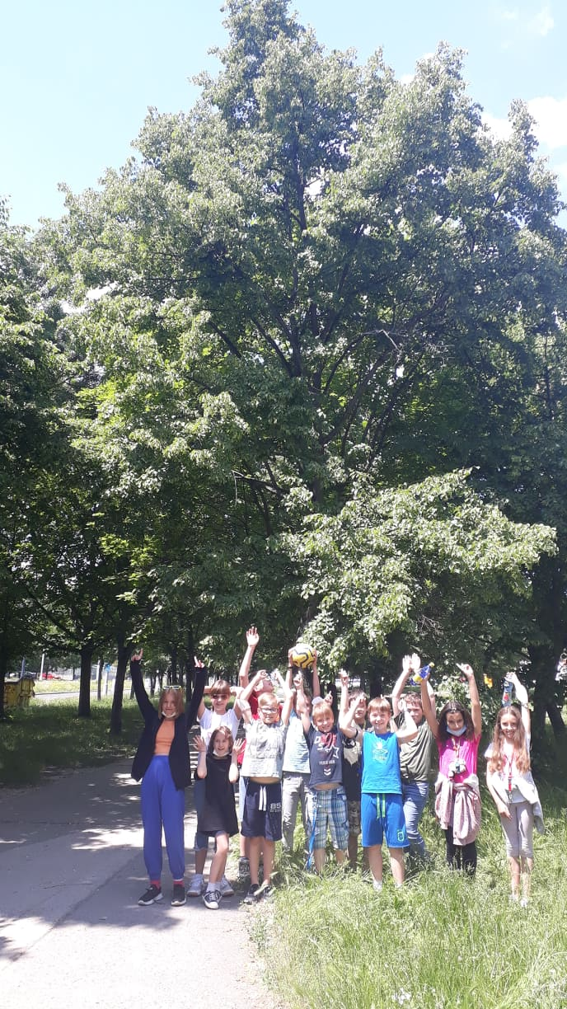

Slide 17
Thank you for your attention

